Slide 1
USED CARS PRICE ANALYSIS
Presented by:
JUWERIYA

Slide 2
PROJECT OBJECTIVE
The objective of this project is to build a web scraping tool that efficiently extracts and analyzes used car listings from the Cars Dekho website. The tool captures structured details including car models, brands, location, price, fuel type, transmission, kilometers driven, and year of manufacture. By automating the data collection process, the project aims to provide regional and brand-wise market insights.
→ This analytical approach will assist buyers and sellers in understanding real-time pricing trends, vehicle depreciation, and value dynamics, ultimately supporting smarter and more transparent decision-making in the used car industry.

Slide 3
MAIN AGENDA
Web Scrapping to collect the data
→ Data Cleaning and Manipulation
→ Visualization and Analysis on various factors like avg price by brand, car distribution by brand….etc.…. to analyze above problem statements.
And in-depth exploration of web scraping and data visualization using Python on the “Car Dekho” website to extract used car data across India. Learn the power of data extraction and visualization for insightful analysis of market analysis, prices, vehicle valuation , and fueltypes.

Slide 4
INTRODUCTION
The Automotive Market, particularly the Used Car Segment, is characterized by rapid fluctuations in pricing and a diverse range of options available to consumers.
By leveraging Web Scraping techniques, we aim to gather essential information such as Car Models, Prices, Specifications and Mileage, which can be analyzed to identify Market Trends And Pricing Patterns.
The Project Will Utilize Python And Libraries Like Beautiful soup And Pandas To Automate The Data Collection Process, Ensuring Efficiency And Accuracy.
Ultimately, The Project Seeks To Enhance Transparency In The Used Car Market, Empowering Stakeholders To Align Their Decisions With Current Market Conditions And Expectations.

Slide 5
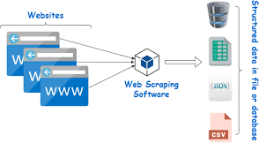
WEB SCRAPPING
Web Scraping is the process of Automatically Extracting Data from Websites. It involves fetching the content of a Web page and parsing it to retrieve specific information, which can be stored and analyzed.
How It Works:
  Fetching: A Web Scraper sends a request to a web server to retrieve the HTML content of a Web Page.
  Parsing: The retrieved html is then parsed to locate and extract the desired data elements, such as text, images, or links.
  Storing: The extracted data Is typically stored in a structured format, such as a csv file, database, or spreadsheet, for further analysis.

Slide 6
TOOLS USED
Software Requirement:-
→ Python(Jupyter notebook)
→ Powerbi
→ Excel
Main Software Libraries:-
→ Pandas
→ Numpy
→ Beautiful Soups
→ Requests
→ CSV

Slide 7
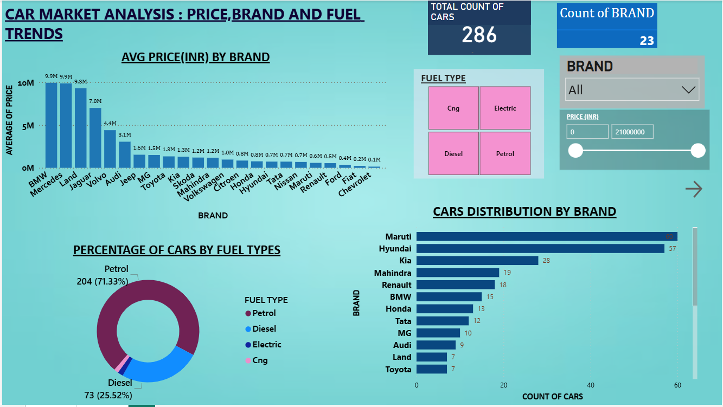
DASHBOARD’S
This is a powerful tool in public speaking. It involves varying pitch, tone, and volume to convey emotion, emphasize points, and maintain interest.
  Pitch variation
  Tone inflection
  Volume control

Slide 8
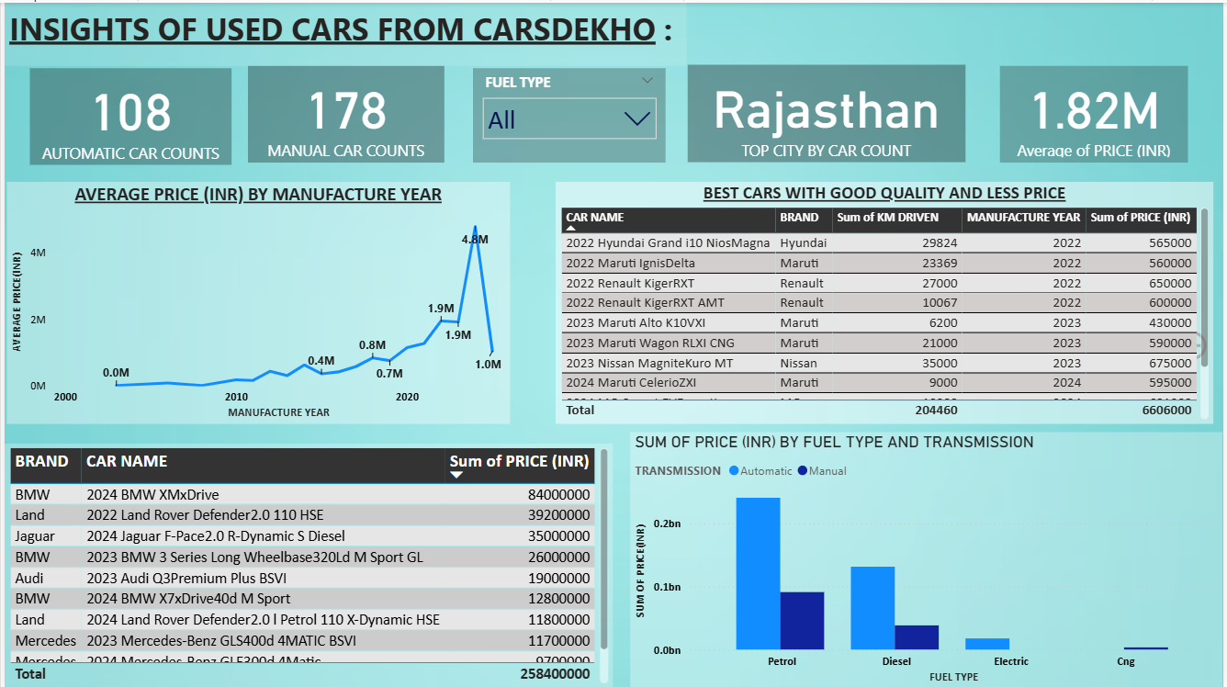

Navigating Q&A sessions
Maintaining composure during the Q&A session is essential for projecting confidence and authority. Consider the following tips for staying composed:
Stay calm
Actively listen
Pause and reflect
Maintain eye contact
Know your material in advance
Anticipate common questions
Rehearse your responses

Slide 9
KEY INSIGHTS
Pricing Overview:
Average Price: ₹1.82 Million
Minimum Price: ₹75,000
Maximum Price: ₹2.1 Crores
Brand Distribution:
Maruti leads the listing count, followed closely by Kia, Hyundai, and Tata, underscoring Maruti’s strong resale presence and widespread affordability.
Luxury brands such as BMW, Jaguar, and Land Rover contribute significantly to cumulative pricing value, especially in recent-year listings.
Fuel Type Breakdown (Donut Chart):
Petrol vehicles account for the majority of listings, confirming their continued dominance in the Indian market.
Diesel vehicles maintain a strong presence, particularly among larger SUVs and multi-state inventories.
Electric and CNG models, while fewer in number, show rising interest—indicating early adoption of greener mobility options.
Transmission Split (Pie Chart):
Manual transmission vehicles are more prevalent overall, reflecting affordability and fuel efficiency preferences.
However, Automatic transmission cars—especially in recent-year entries—command higher average prices and show growing traction among premium urban buyers.

Slide 10
Thank you
.

